Slide 2


Sounds + blending = reading
+
I want to help you understand how your child is learning to read words in Read Write Inc. Phonics by blending sounds together:
Alongside teaching children sounds, we teach them to blend sounds to read words e.g. s-a-t, sat.
We use Fred Talk to help children read.

Slide 3
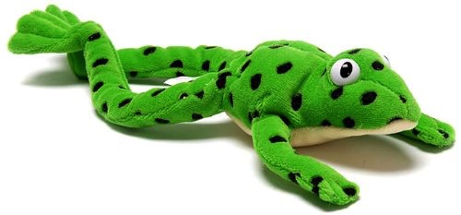
Fred
Let me introduce you to Fred.
Fred can only speak in sounds. He says d-o-g, h-a-t etc.
Speaking like Fred helps children to understand that words are made up of sounds.
Fred helps children practise blending sounds together because he needs the children to say the words for him. Fred says d-o-g, children tell him the word is dog.
This is how we quickly teach all of our children to blend.
Notes:
Let me introduce you to Fred.
Fred can only speak in sounds. He says d-o-g, h-a-t etc.
Speaking like Fred helps children to understand that words are made up of sounds.
Fred helps children practise blending sounds together because he needs the children to say the words for him. Fred says d-o-g, children tell him the word is dog.
This is how we quickly teach all of our children to blend.

Slide 4

Fred Talk routine
Say the word in sounds as Fred e.g. c-a-t.
Ask your child to repeat. Can they ‘jump-in’ with the whole word?
Say the word in sounds followed by the whole word e.g. c-a-t, cat
Ask your child to repeat

Slide 5
Fred games and Fred talk throughout the day
l
-u
?
Shall we have some
What would you like to
Let’s put on your
-ch
-n
-ay
-l
p
?
-oa
-t
c
.
Try to use Fred Talk throughout the day at home to help your child practise blending sounds together.
Fred Talk words at the end of the sentence and keep the words short and simple.
Notes:
You can also play Fred Games with your child at home. I will show you one of these in action in a moment,

Slide 6




Reading with Fred Talk
We teach children to read words using Fred Talk to blend together the sounds they know e.g. m-a-t, mat.
We say ‘Fred Talk, read the word’.
Notes:
We teach children to read words using Fred Talk to blend together the sounds they know e.g. m-a-t, mat.
We say ‘Fred Talk, read the word’.

Slide 7
What can I do?
1. Speak like Fred throughout the day
2. Play Fred games
3. Use ‘Fred Talk, read the word’ to read words

Slide 8
Online resources available
Ruth Miskin Parents’ Page:
http://www.ruthmiskin.com/en/parents/
Ruth Miskin Facebook:
https://www.facebook.com/miskin.education
Free e-books for home reading:
http://www.oxfordowl.co.uk/Reading/

