Slide 1
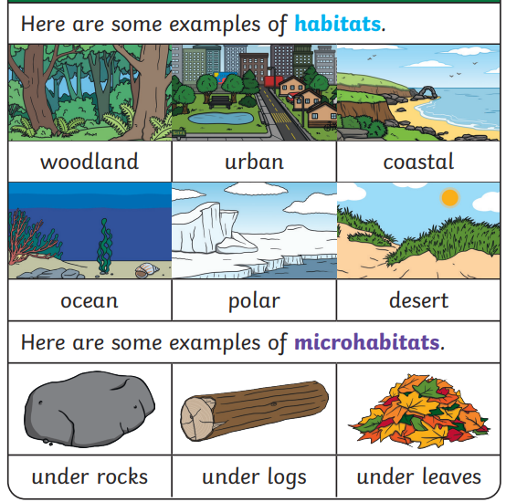


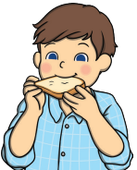

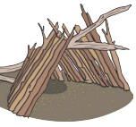
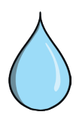
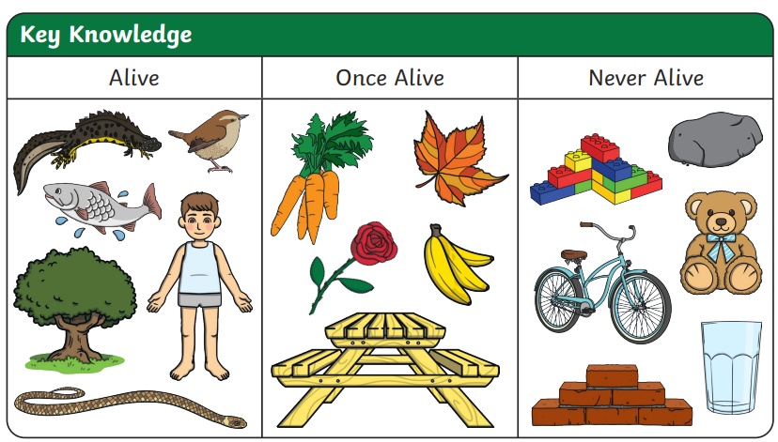

Key Vocabulary
habitat | A habitat is the natural home of a living thing. It gives them what they need to survive.
microhabitat | A microhabitat is a very small habitat that minibeasts live in.
shelter | Habitats provide shelter for plants and animals.
depend | Living things in a habitat depend on each other to survive.
survive | To survive means to stay alive.
food sources | Food sources are the things that living things eat.
Basic needs are the things that living things need to stay alive. Living things need shelter, food, water and air to survive.

